Slide 1
Conducting OR in the early stages of technology development
The Bright Corvus Approach
Becky Barlow, Principal Operational Researcher
DSTL/CP170200, 16th July 2025
© Crown Copyright 2025, Dstl

Slide 2
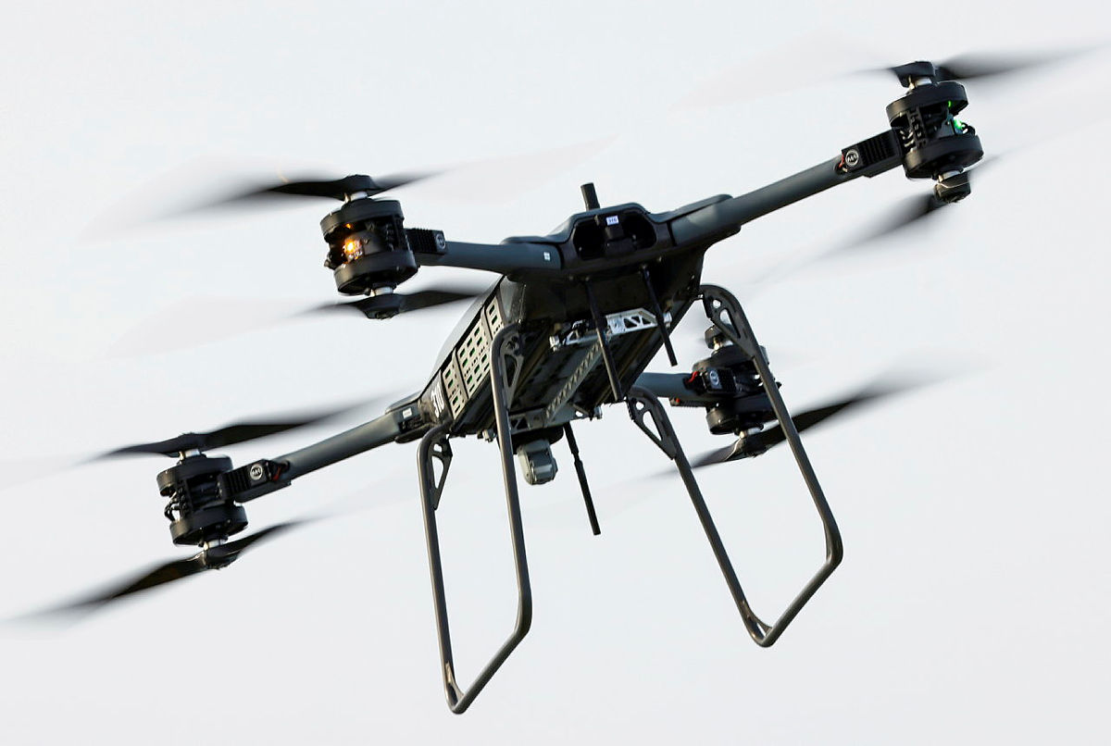
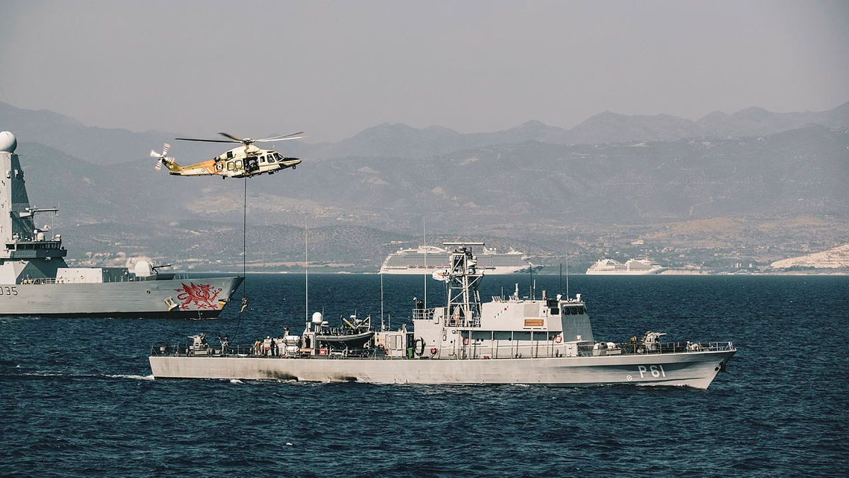
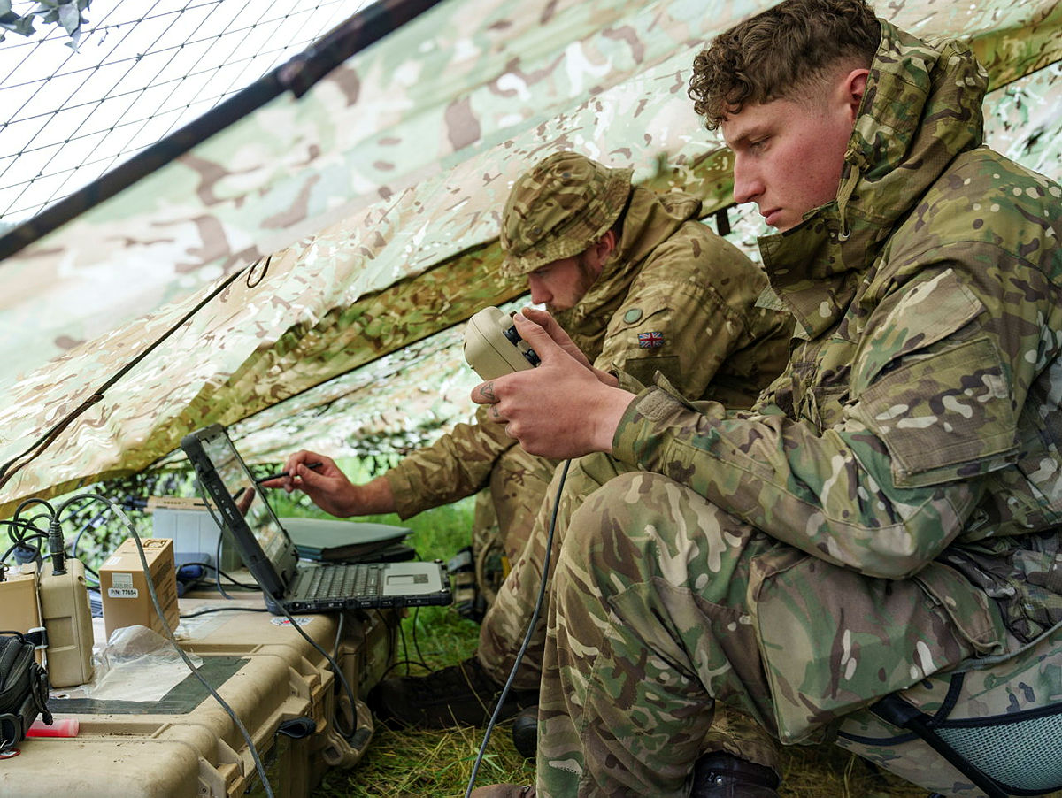
CONTENT
Bright Corvus Project Overview
Task Requirement
Method
OR Techniques
Lessons Learnt
DSTL/CP170200

Slide 3
BRIGHT CORVUS OVERVIEW
UK Government Spending Review 2020 (SR20) Project
Family of distributed, tightly-integrated, networked, scalable, multifunction RF sensors, effectors and enablers
Freedom of Action and Movement in GNSS and GPS denied environments
£55 Million investment in UK Defence S&T
Replacement of single monostatic systems
  Exquisite
  Bespoke
  Expensive
With multiple modular multistatic systems
  More flexible
  More agile
  Lower SWaP-C
  Greater availability
  Greater utility
DSTL/CP170200
Notes:
Acronyms:
SR: Spending Review
RF: Radio Frequency
GNSS: Global Navigation Satellite System
GPS: Global Positioning System
SWaP: Size, Weight and Power and Cost
S&T: Science & Technology

Slide 4
AN ENTERPRISE APPROACH
Dstl
L3Harris
QinetiQ
Leonardo
Roke
Futures Lab
Mode Black
Xenint
Autonomous Devices
Serapis Framework
University of Birmingham
Far Field Exploits
University of Edinburgh
Canny Comms
SAAB
Cranfield University
Thales
Astrid
Plextek
Red Scientific
UCL
Cambridge Consultants
MAC Ltd
University of Liverpool
MISL Ltd
MAIAR
Mind Foundry
Defence and Security Accelerator
Chelton
Optect
Orolia
Rowden
University of Manchester
DSTL/CP170200
4
UK OFFICIAL

Slide 5
THE OR EXPERIMENT
The questions posed…
What would happen if you use OR in a technology push project?
Could it produce anything useful?
Could it help to exploit the technology?
…Is it even feasible to conduct OR on such low TRL technologies?
DSTL/CP170200

Slide 6
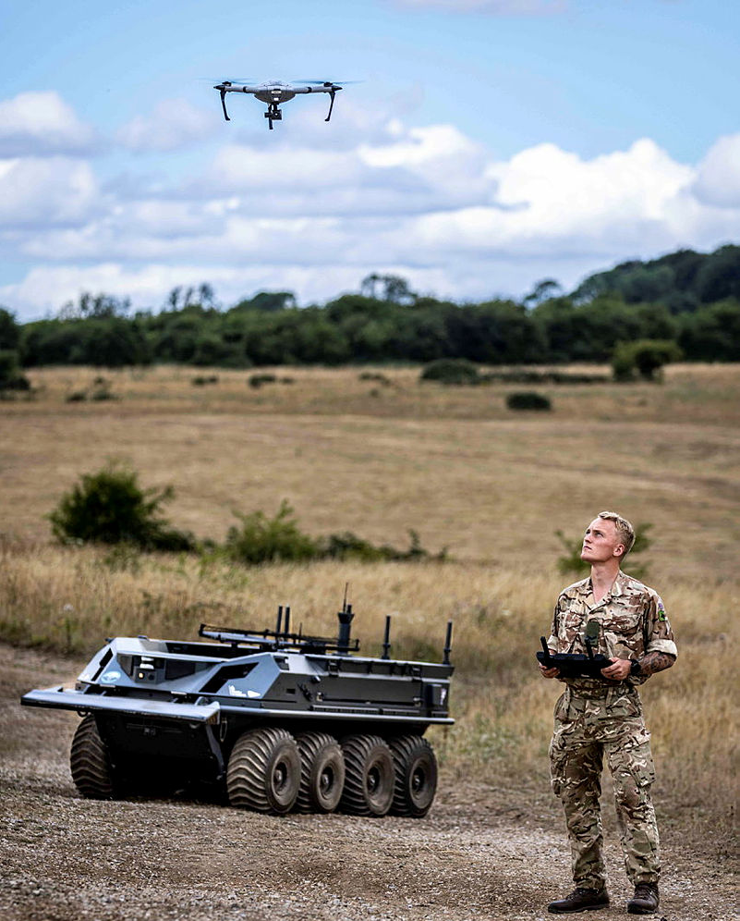
WHY LOOK AT UTILITY SO EARLY?
To guide technical development
To ensure we are focused on the needs of the military
To push technical developments in areas that maximise utility
To prioritise technologies for further development
DSTL/CP170200

Slide 7
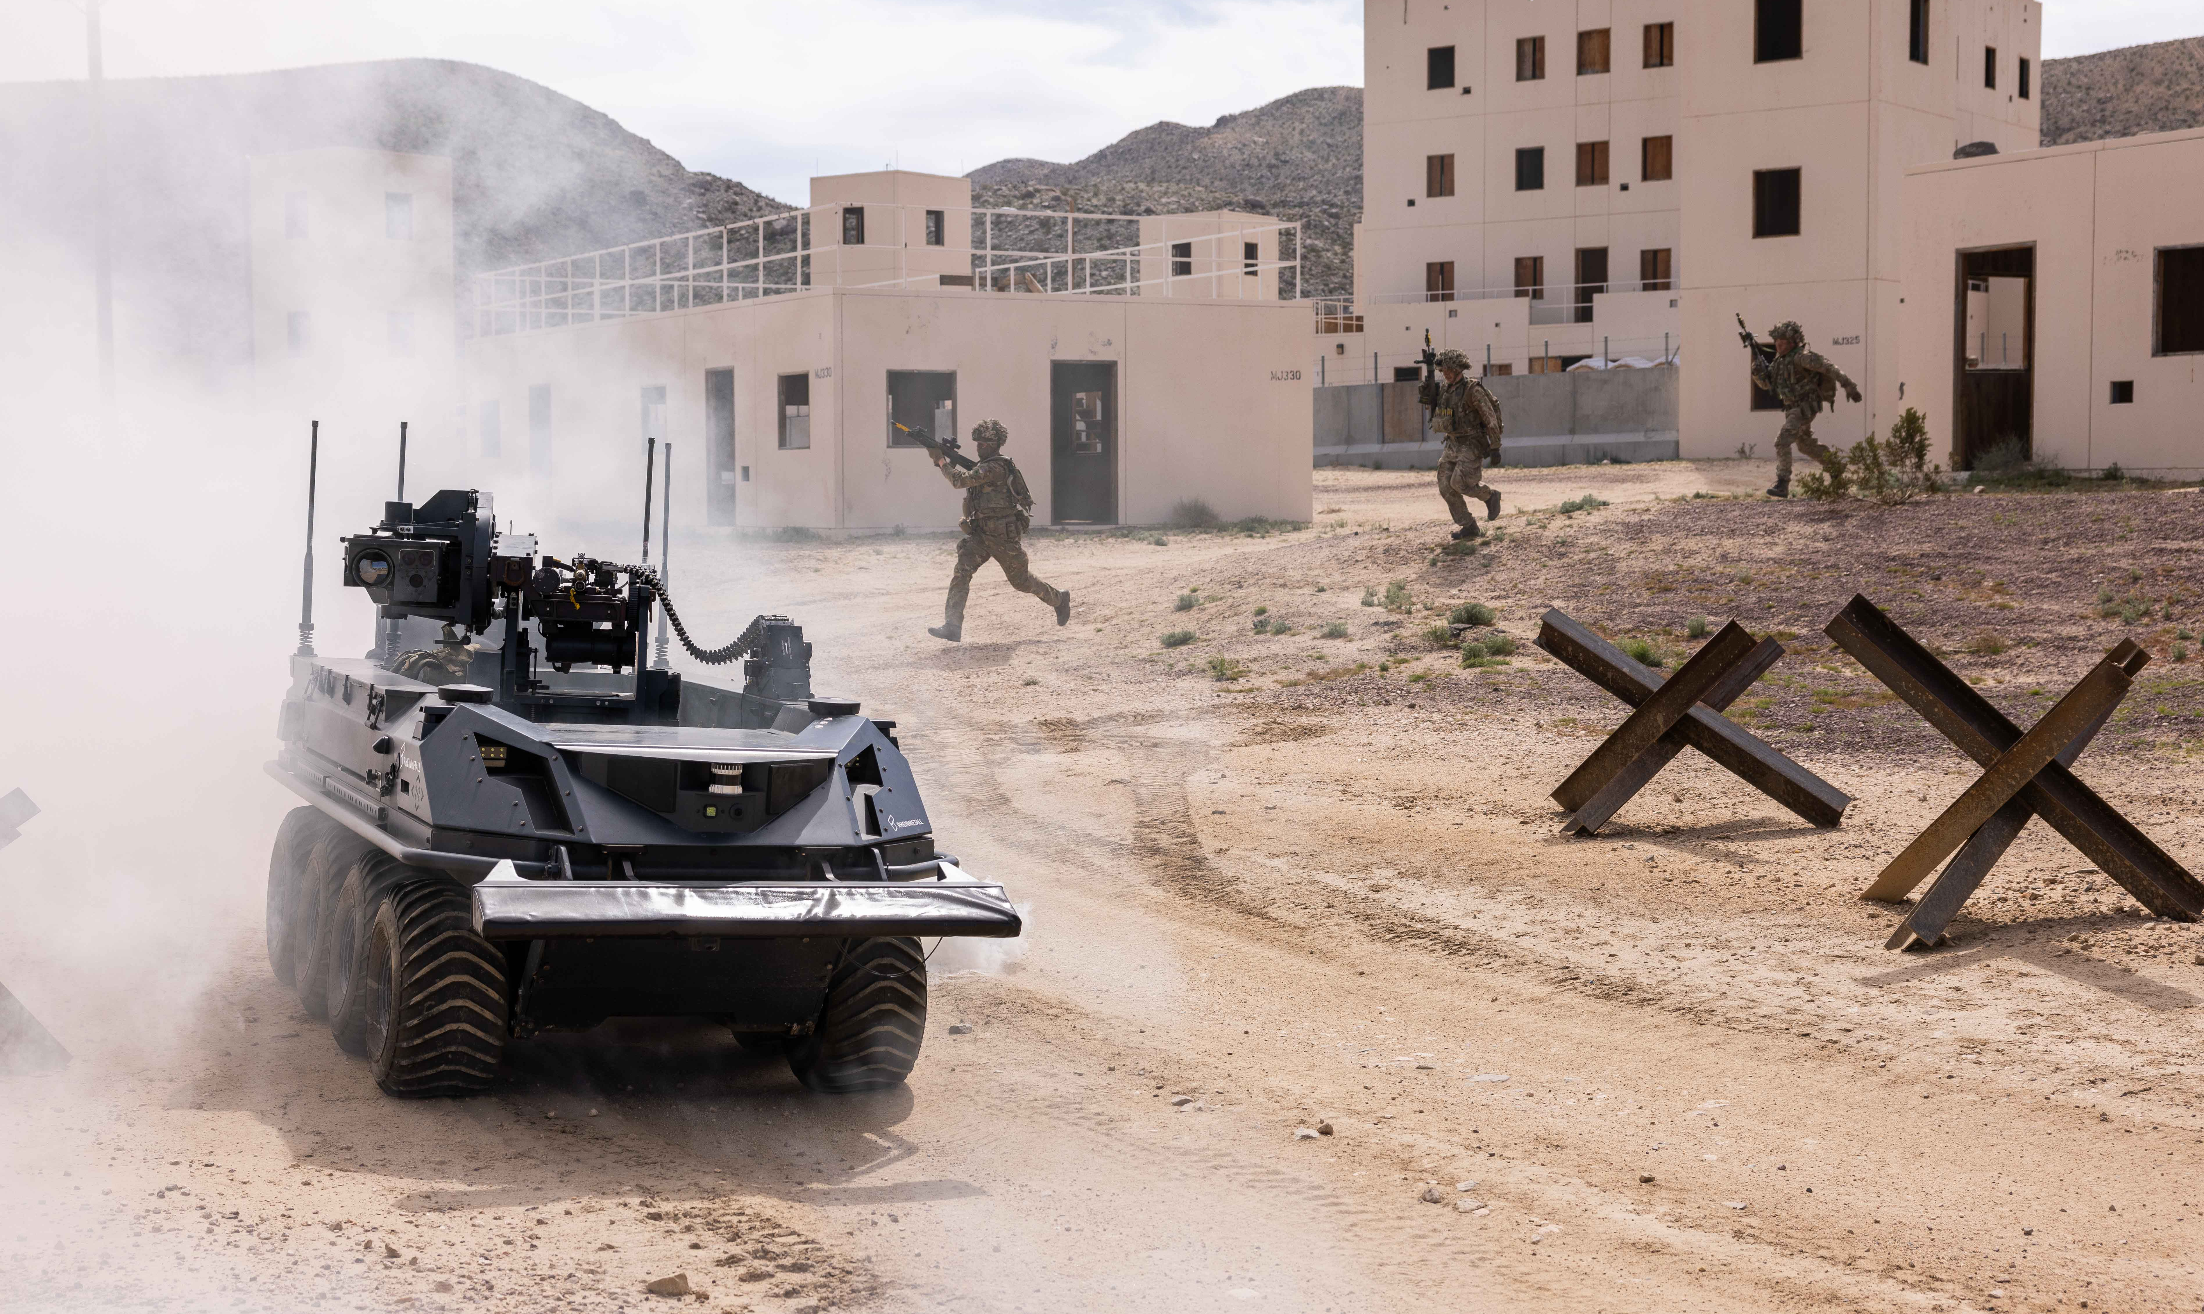
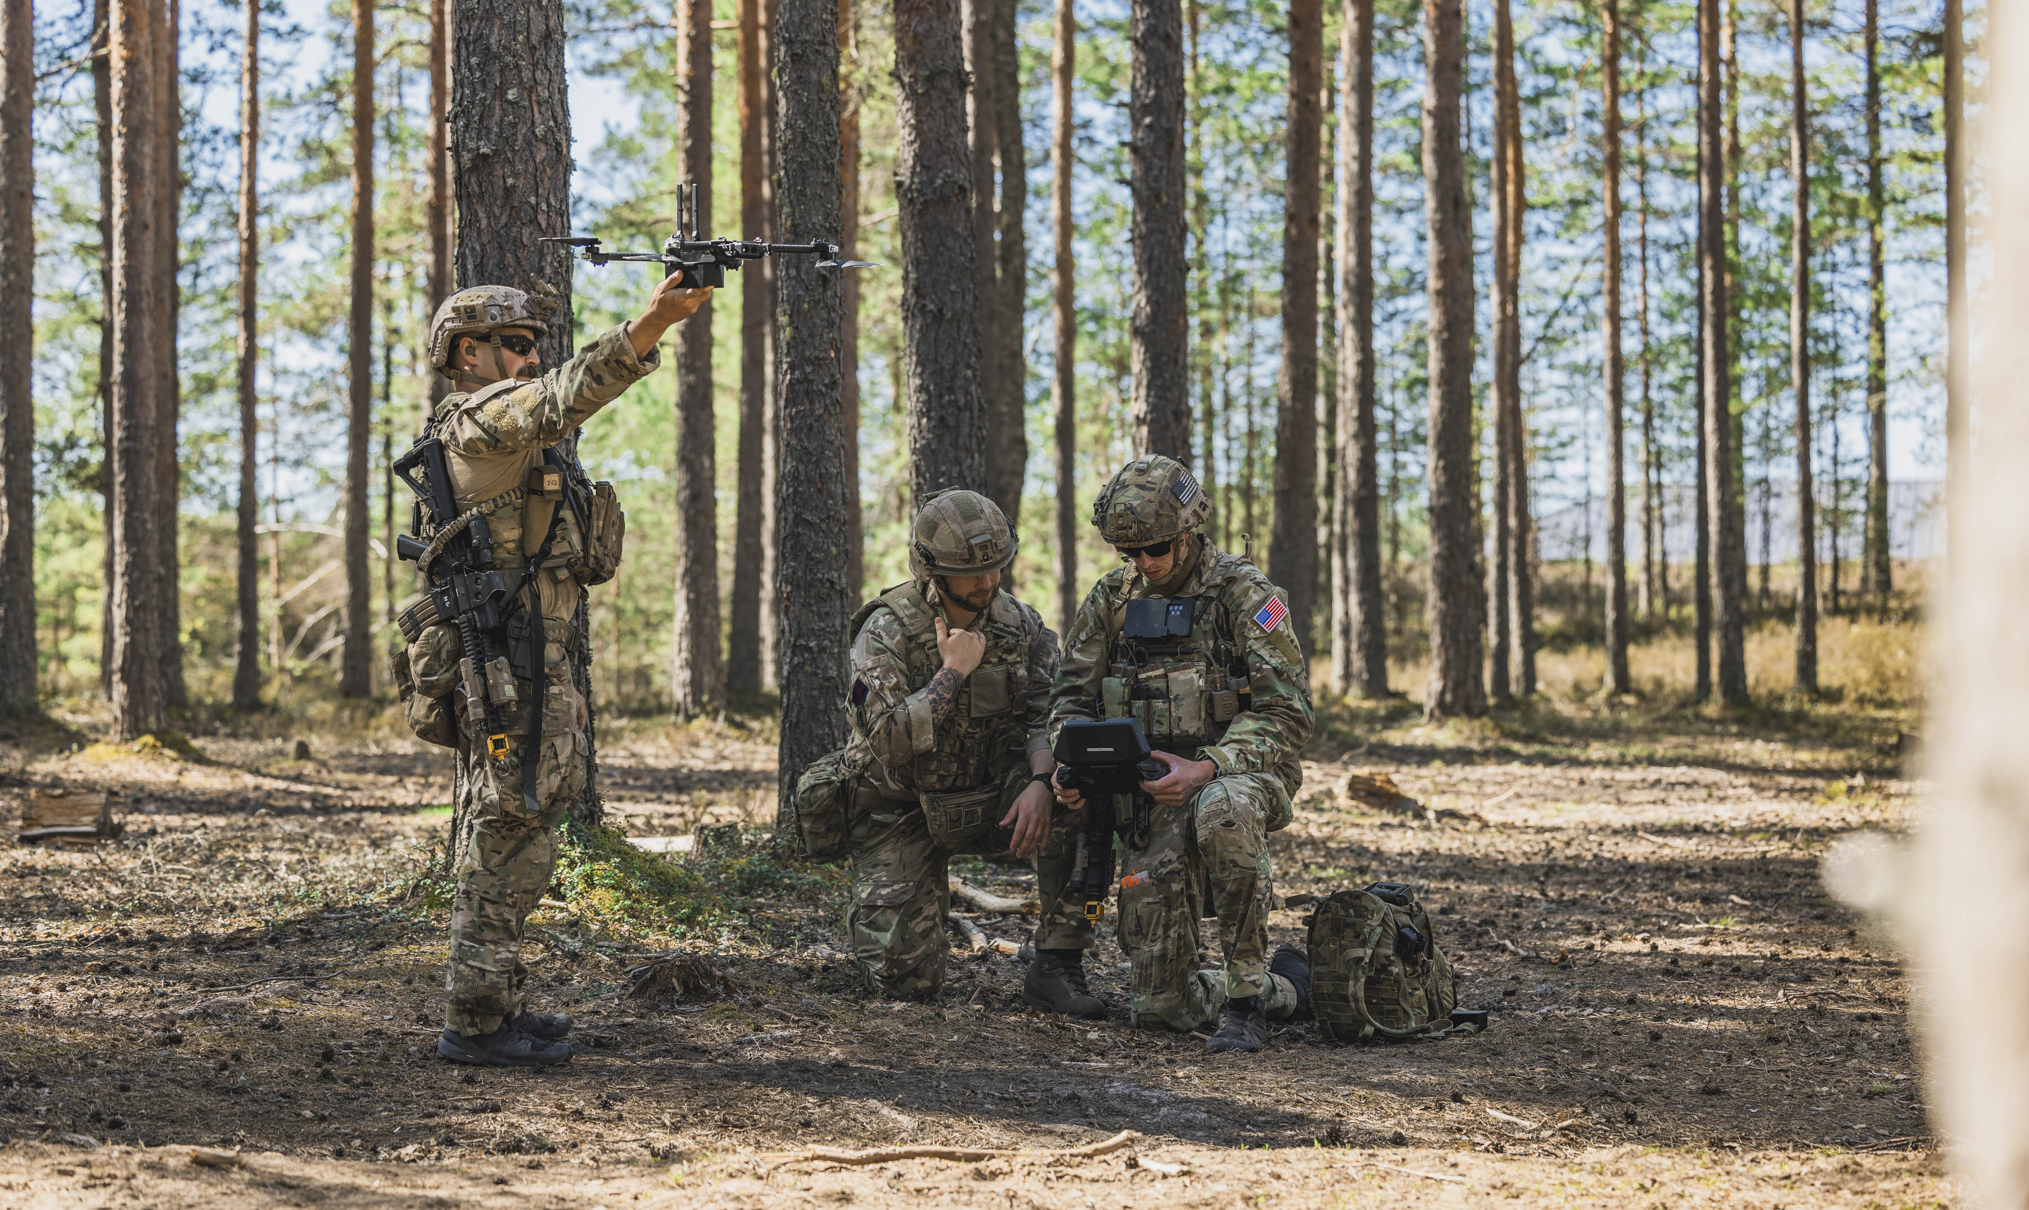
THE TASK
To analyse:
The military utility of the Bright Corvus technologies
Which technologies the MOD should invest more money into going forward
Which parametric changes would significantly improve the utility of the Bright Corvus technologies
DSTL/CP170200

Slide 8
OR TO ASSESS MILITARY UTILITY
Operational Research for Bright Corvus has been designed to assess the elements of military utility
  Do they fill any recognised capability gaps or future requirements?
  Are there any key insights that come out of the initial DLOD assessment that highlight any specific issues (only high level at this stage)?
Military Utility
Effectiveness
Suitability
Affordability
How do the technologies perform in a range of different feasible missions?
What benefits do they provide?
Which technologies are worth further investment and why?
What are the system tradeoffs and what's the optimum configuration?
  What are the ROM costs of the different technologies?
  What are the key cost drivers?
DSTL/CP170200
Notes:
Acronyms:
DLOD: Defence Lines Of Development
ROM: Rough Order of Magnitude

Slide 9
THE APPROACH
Operational Research involves five stages:
Stage 1
Technology down selection
Stage 2
OR method development
Stage 3
Concept boundaries
Stage 4
Low-level assessment
Stage 5
High-level assessment
  Technology filtering using a structured approach
  OR interface identification
  Benefits framework
  Collaborative Dstl/industry approach
  Concept exploration workshops
  Technology utility panels
  Concept cards
  Scenario booklet
  CONUSE
  Task performance analysis
  Benefits assessment
  Tradespace analysis
  ROM costs
  Strategic intent assessment
  Mission level simulation modelling (MACE)
  Expendability assessment
  Survivability assessment
DSTL/CP170200
Notes:
Acronyms:
CONUSE: CONcept of USE
ROM: Rough Order of Magnitude
MACE: Modern Air Combat Environment

Slide 10
THE APPROACH
Operational Research involves five stages:
Stage 1
Technology down selection
Stage 2
OR method development
Stage 3
Concept boundaries
Stage 4
Low-level assessment
Stage 5
High-level assessment
  OR interface identification
  Benefits framework
  Concept exploration workshops
  Technology utility panels
  Mission level simulation modelling (MACE)
DSTL/CP170200
Notes:
Acronyms:
MACE: Modern Air Combat Environment

Slide 11
ASSESSMENT METHODS
DSTL/CP170200

Slide 12
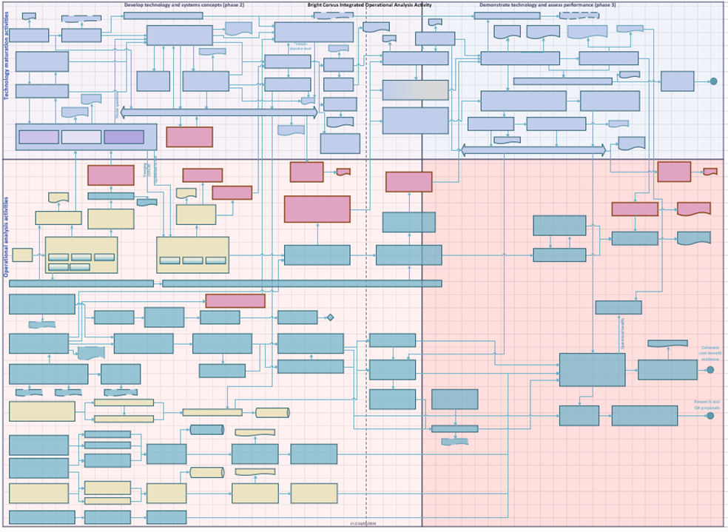
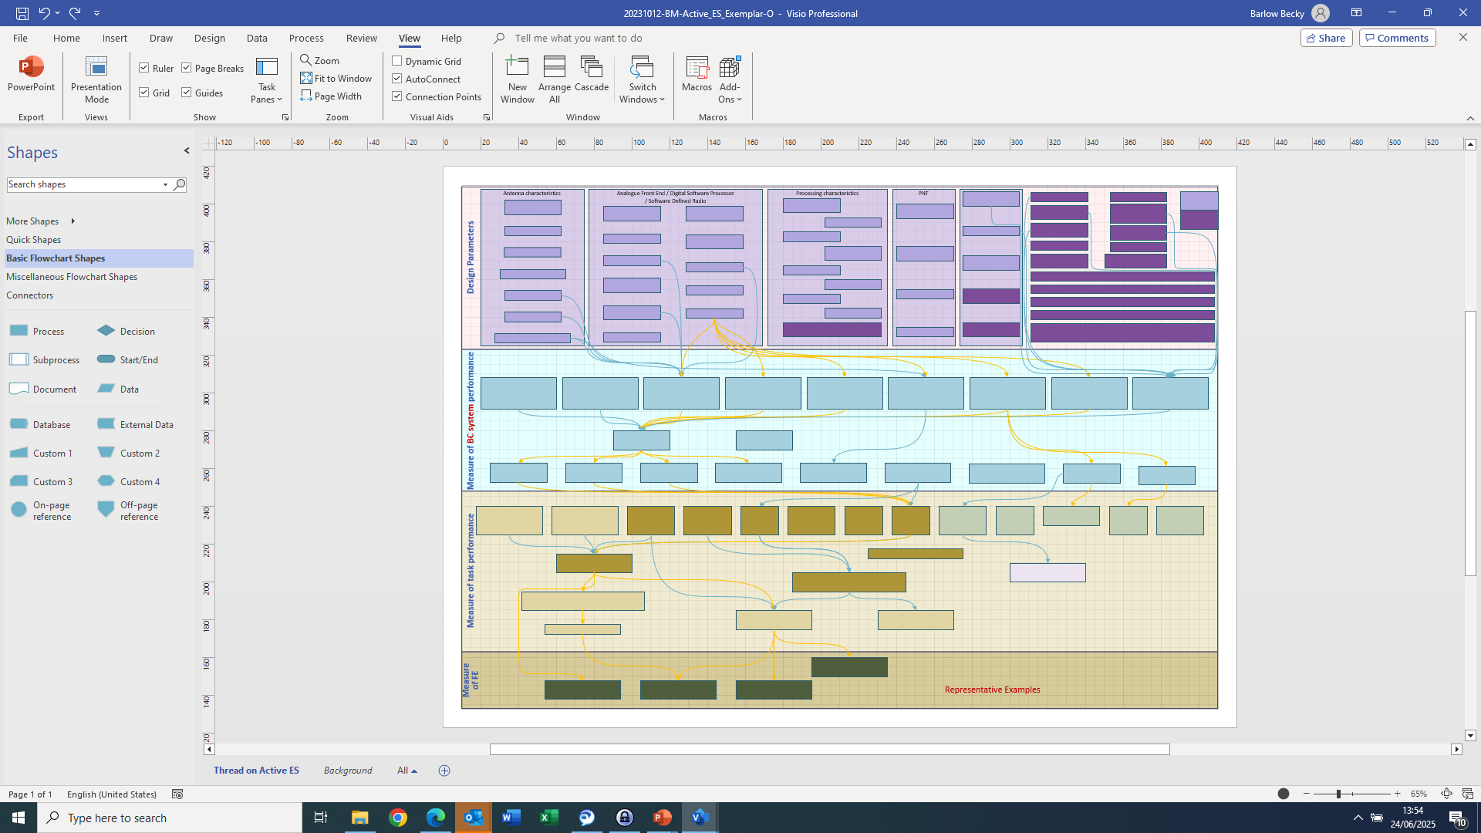
OR METHOD DEVELOPMENT
OR Interface Identification
  Identify dependencies
  Communication aid
Benefits framework
  To understand the relationship between the industry and Dstl OR
OR interface Identification
Benefits framework
DSTL/CP170200

Slide 13
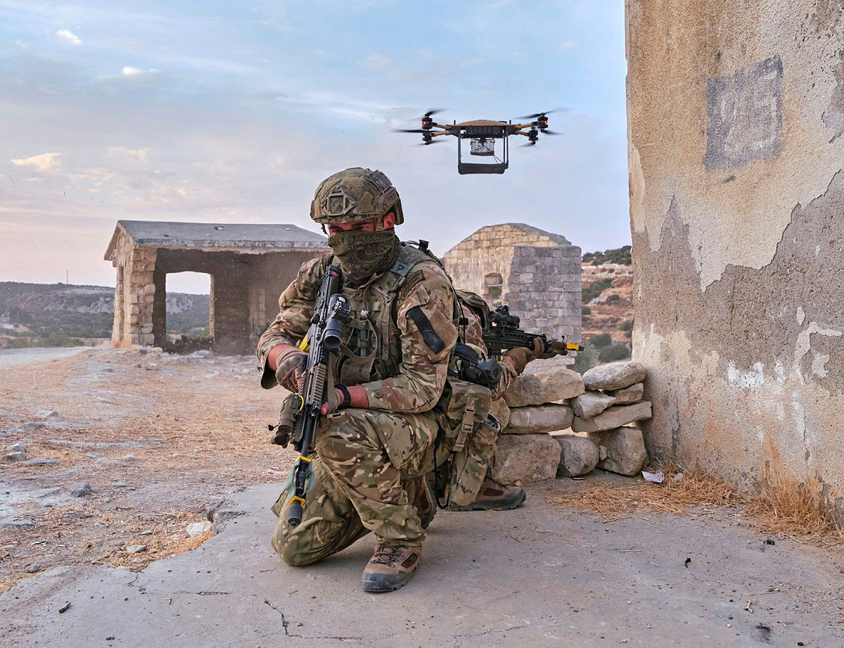

CONCEPT BOUNDARIES
What: Activities to improve understanding of what potential capabilities can offer to MOD
  How: Structured seminal wargames & workshops to bring together SMEs, suppliers and military advisors to improve understanding of:
How the technologies could be used
Benefits and disadvantages of using the technologies in certain ways
Other uses that might not naturally be considered
Why: To identify boundaries and scope of operational concepts
DSTL/CP170200
Notes:
Acronyms:
MOD: Ministry Of Defence
SMEs: Subject Matter Experts

Slide 14
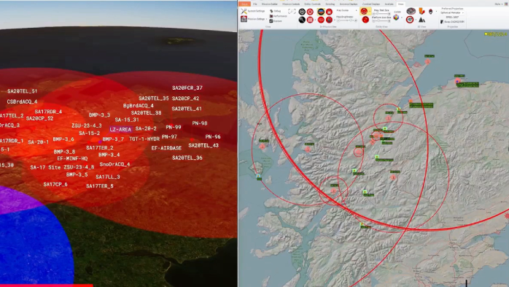
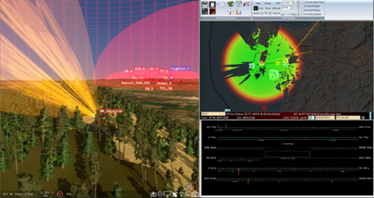
TECHNOLOGY ASSESSMENT
What: The military impact of using the different Bright Corvus technologies against a range of different military utility metrics:
Ability to complete missions quicker
Ability to locate the adversary more accurately
The mission impact of doing so
How: Using a range of simulation and visualisation models across Dstl and the Bright Corvus suppliers
Why: To compare the technologies against a simple baseline to indicate the effects on mission performance
DSTL/CP170200

Slide 15
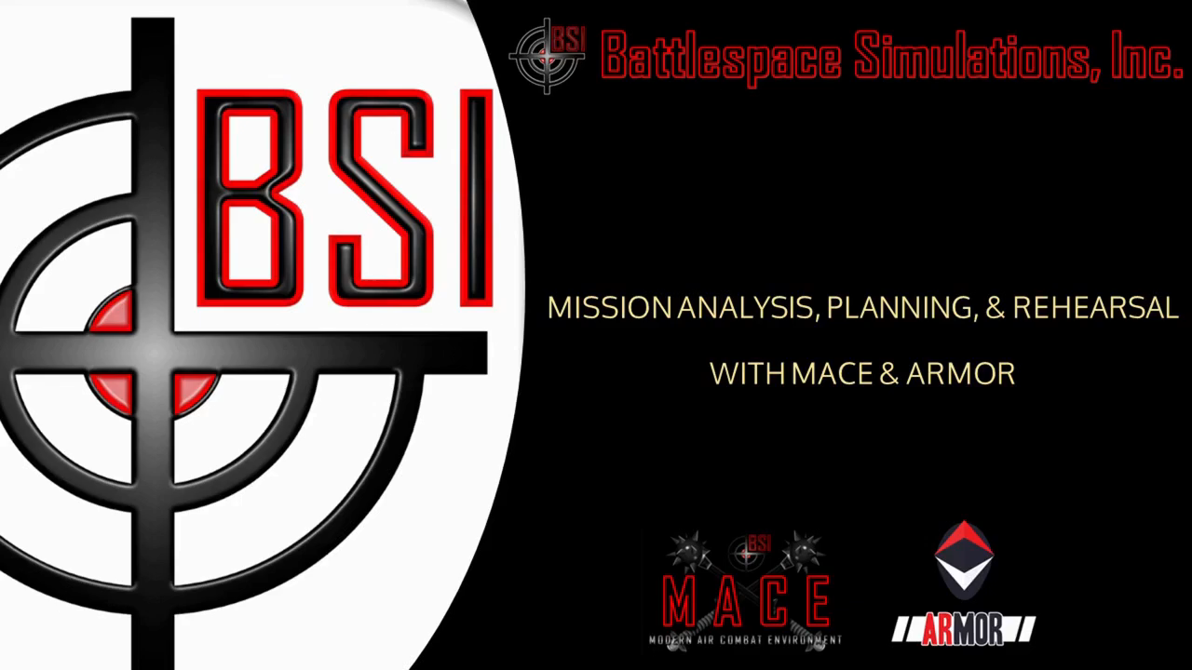
MISSION LEVEL SIMULATION MODELLING (MACE)
BSI, https://www.youtube.com/watch?v=Uv-7mPep9pk
DSTL/CP170200
Notes:
Acronyms:
BSI: Battlespace Simulations Inc

Slide 16
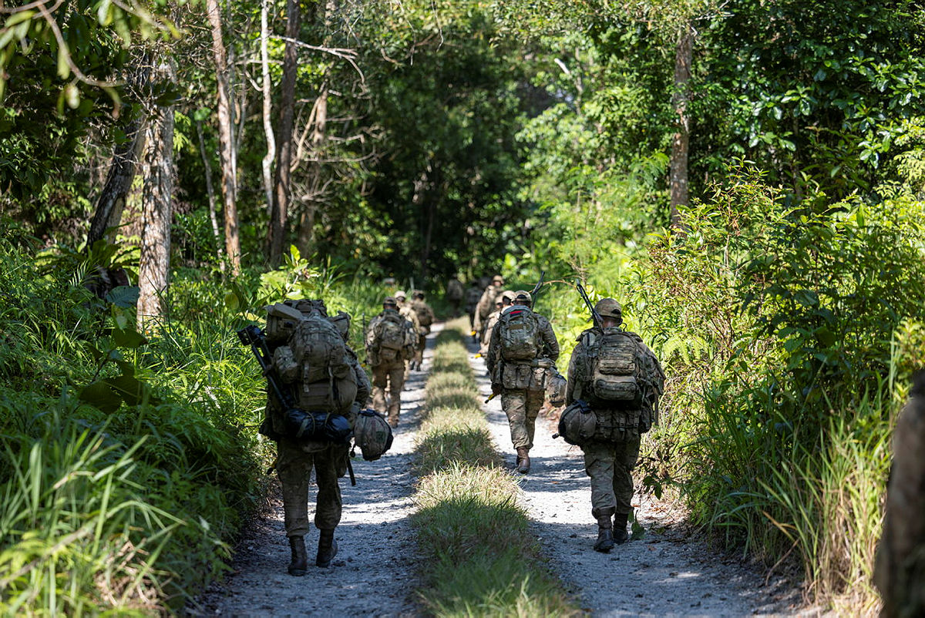
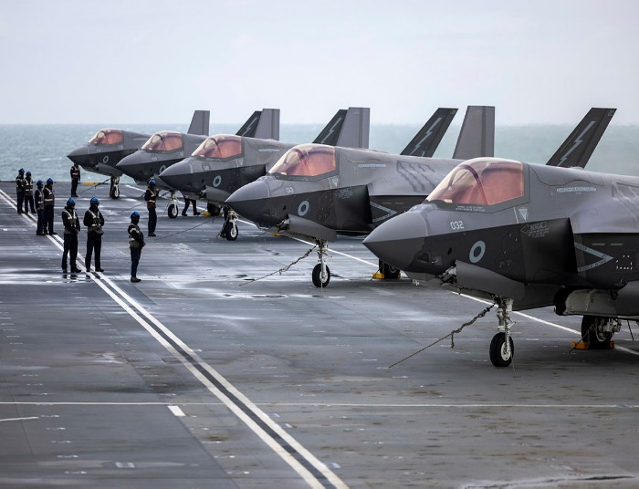
PRIORITISATION
Using the results from the analysis, an initial prioritisation of the technologies was completed
Prioritisation reflects varying customer requirements – weights in the model are adjusted accordingly
The results were analysed, supported by Dstl Military Advisor judgement on likely utility
Prioritisation is helping Front Line Commands (FLC’s) and future programmes to decide the technologies on which to focus their effort and funding
DSTL/CP170200
Notes:
Acronyms:
FLC: Front Line Command

Slide 17
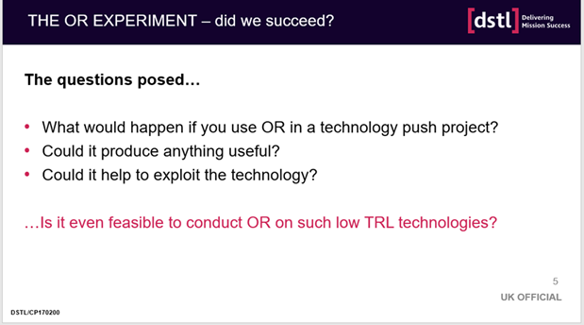
REFLECTIONS
(Overcome) Challenges
  Very limited data
  Novel technologies
  Rapidly changing information
  Significant number of industry suppliers
  The number of different RF technologies that needed to be assessed
  Lack of OR understanding in stakeholders
Successes
  Valuable addition to the project
  Useful evidence
  Aided exploitation
  Good stakeholder engagement
  Programme Innovation Award
DSTL/CP170200
Notes:
Acronyms:
RF: Radio Frequency

Slide 18
THE APPROACH - REMINDER
Operational Research involves five stages:
Stage 1
Technology down selection
Stage 2
OR method development
Stage 3
Concept boundaries
Stage 4
Low-level assessment
Stage 5
High-level assessment
  Technology filtering using a structured approach
  OR interface identification
  Benefits framework
  Collaborative Dstl/industry approach
  Concept exploration workshops
  Technology utility panels
  Concept cards
  Scenario booklet
  CONUSE
  Task performance analysis
  Benefits assessment
  Tradespace analysis
  ROM costs
  Strategic intent assessment
  Mission level simulation modelling (MACE)
  Expendability assessment
  Survivability assessment
DSTL/CP170200
Notes:
Acronyms:
CONUSE: CONcept of USE
ROM: Rough Order of Magnitude
MACE: Modern Air Combat Environment

Slide 19
Any Questions
DSTL/CP170200

Slide 20

The contents include material subject to © Crown copyright (2025), Dstl. This information is licensed under the Open Government Licence v3.0. To view this licence, visit https://www.nationalarchives.gov.uk/doc/open-government-licence/.
Where we have identified any third party copyright information you will need to obtain permission from the copyright holders concerned. Any enquiries regarding this publication should be sent to: centralenquiries@dstl.gov.uk or [other author(s) / authoring organisation(s)]."
DSTL/CP170200

